Slide 1
Intro to: Exception Handling

Slide 2
TABLE OF CONTENTS
01
02
03
04
INTRODUCTION
Why?
What is exception handling?
Is it important?
Keywords
Creating Exceptions
Try, catch, finally, and throw.

Slide 3
01
INTRODUCTION
What is exception handling?

Slide 4
Exception
An event that disrupts the normal flow of the program's instructions. Examples include division by zero, file not found, or an invalid input.

Slide 5
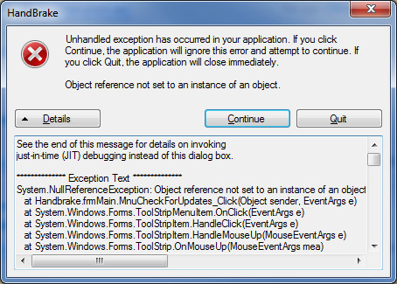

Slide 6
What is exception handling?
Exception handling is a mechanism in programming languages to manage errors and exceptional situations that occur during the execution of a program. It helps in maintaining the normal flow of the program even when an unexpected event or error occurs.

Slide 7
02
Why?
Is it important?

Slide 8
Main reasons
Robustness and Reliability
01
Exception handling helps create robust and reliable programs by ensuring that unexpected errors are properly managed. Without it, a program might crash or produce incorrect results when an error occurs.
Program Continuity
02
It allows a program to continue running even when an error occurs. For instance, in a web server, if one request fails, exception handling ensures that the server can continue to handle other requests without crashing.
Separation of Error Handling Code
03
Exception handling separates error handling code from regular code, making the code cleaner and easier to read and maintain.

Slide 9
04
User Experience
It improves the user experience by providing meaningful error messages and handling errors in a user-friendly manner. Instead of displaying a cryptic error message or crashing, the program can inform the user about the problem and suggest possible actions.

Slide 10
03
Keywords

Slide 11
Keywords
Try block
Catch block
A block of code where exceptions might occur. You write the code that you think might cause an exception inside this block.
A block of code that handles the exception. When an exception occurs in the try block, control is transferred to the corresponding catch block.
Finally block
Throw
A block of code that is always executed, regardless of whether an exception occurred or not. It is typically used for cleanup activities like closing files or releasing resources.
The action of creating an exception object and signaling that an exceptional situation has occurred.

Slide 12
04
Creating Exceptions

Slide 13
Steps to Create a Custom Exception
1-Create a new class that inherits from the `Exception` class.
2- Provide multiple constructors to support different use cases:
-Default Constructor: For creating an exception without additional information.
-Message Constructor: For passing a custom error message.
-Inner Exception Constructor: For linking related exceptions, providing a chain of errors.

Slide 14
Thank You!

